Slide 1
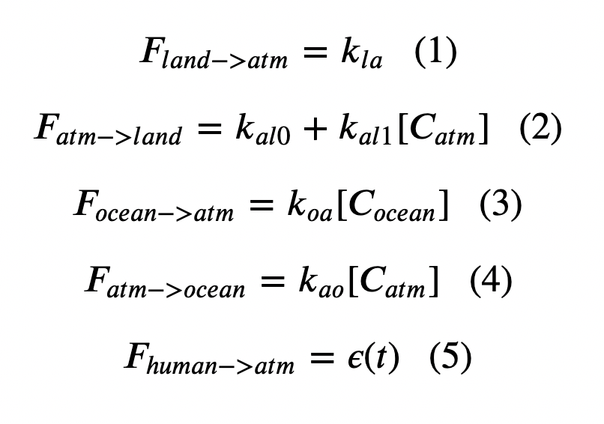
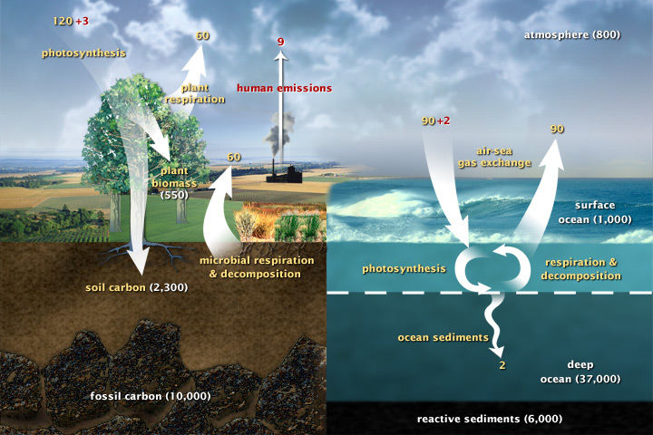
Week 6 – Cambio1.0

Slide 2
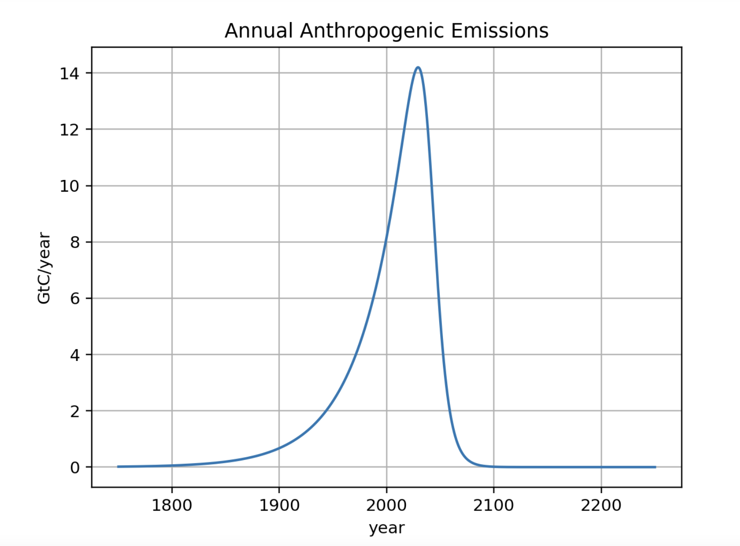
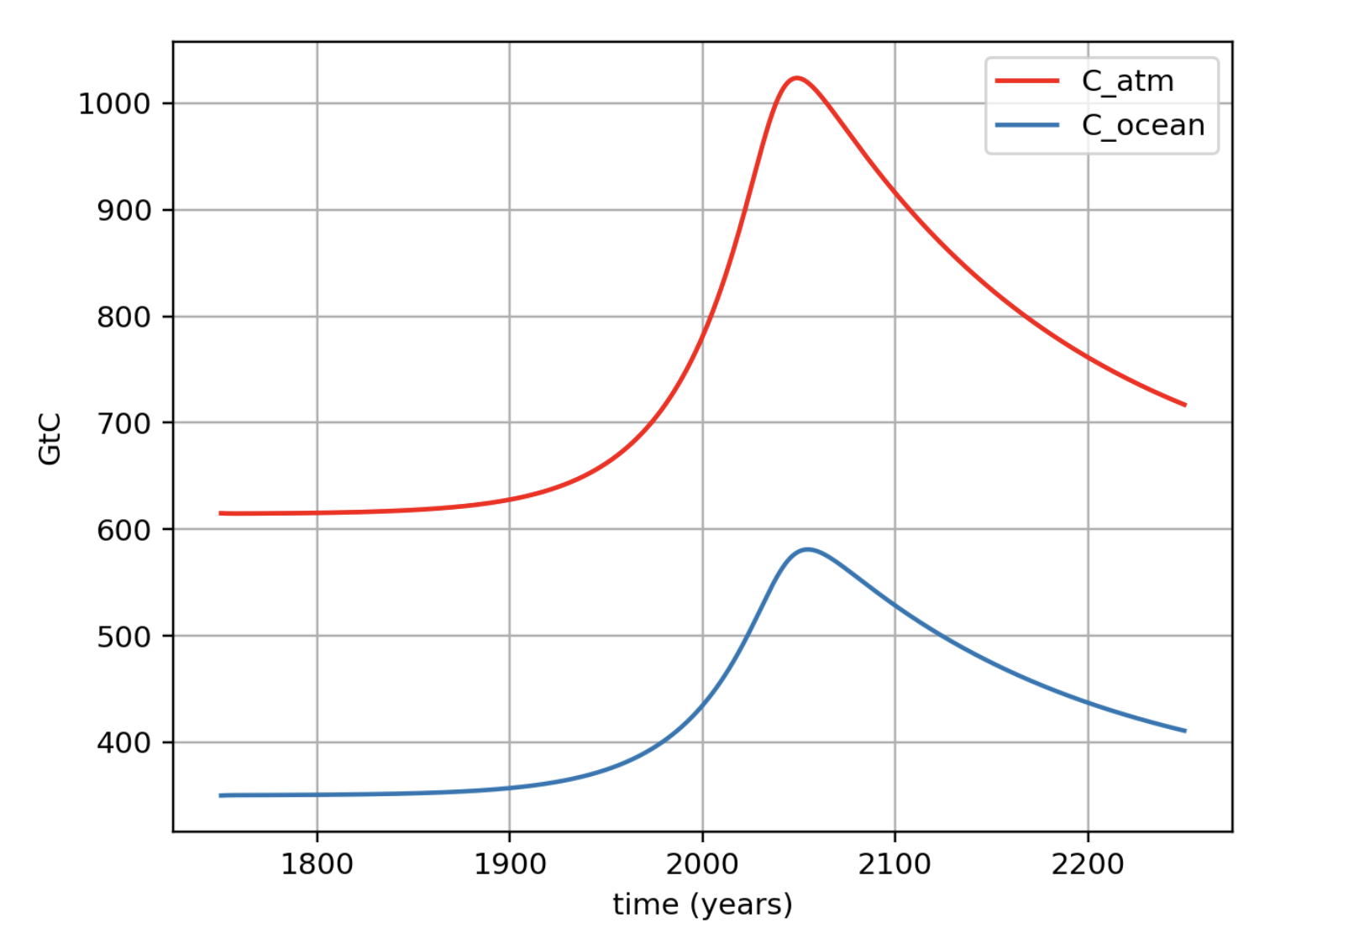
Week 6 – Cambio1.0
Emissions (GtC/year)
Amount of Carbon (GtC)

Slide 3
Week 6 – Cambio1.0
Emissions (GtC/year)
Post peak-emissions delay
Amount of Carbon (GtC)

Slide 4
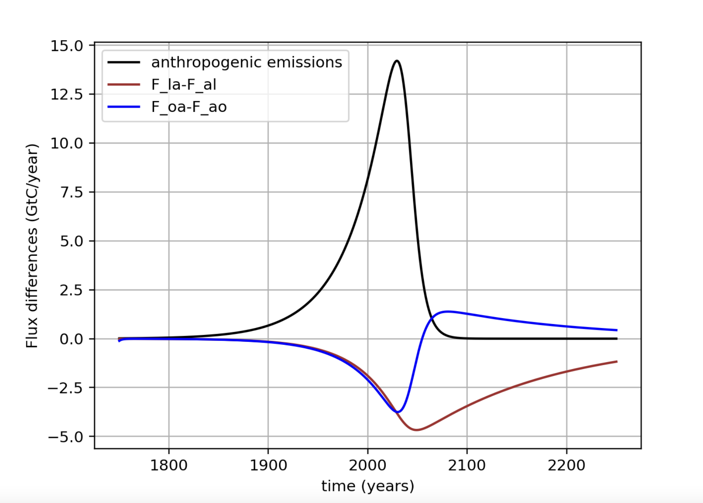
Week 6 – Cambio1.0

Slide 5
Week 6 – Cambio1.0

Slide 6
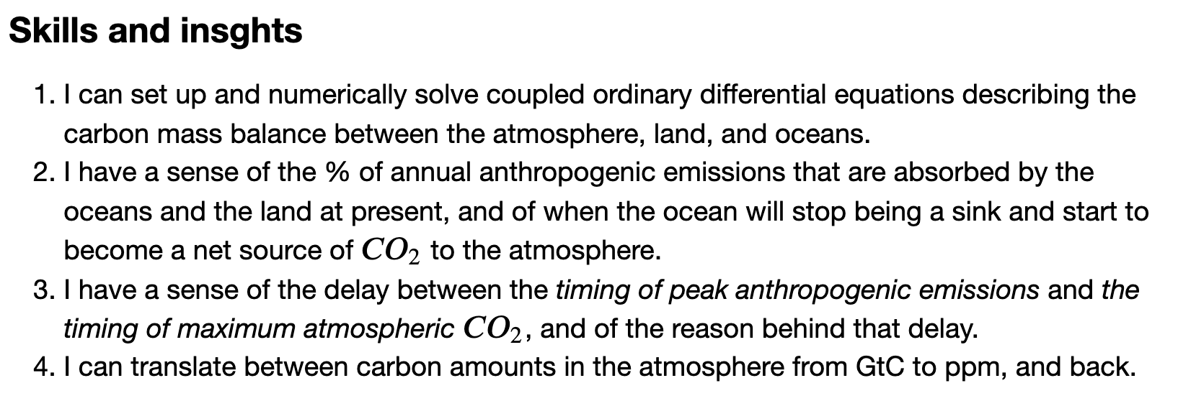
Week 6 – Cambio1.0

